Slide 1
Comprehensive Planning Highway to Continuous Improvement and Success
Meeting E-rate
Technology Plan Requirements
October 2012
Joan Adams
Supervisor of IT Projects
paplanning@caiu.org
717.732.8403
Jason Conway
Statewide Project Coordinator
Comprehensive Planning
paplanning@caiu.org
717-732-8403
Julie Tritt Schell
PA E-rate Coordinator
jtschell@comcast.net
717.730.7133

Slide 2
Purpose of Webinar
Explain new E-rate technology plan requirements
Explain Comp Plan Phases
Explain how to transition from eStrategic Planning Phases to Comp Plan Phases
Explain how to use Comprehensive Planning Process to meet technology plan requirements
Explain deadlines and approval process
How to register for additional E-rate training

Slide 3
New E-rate Technology Plan Rules
Beginning with Funding Year 2011, E-rate rules require only schools applying for Priority 2 funding to have an approved technology plan
Priority 2 funding consists of Internal Connections and the Basic Maintenance of Internal Connections
Commonly, only schools with a NSLP eligibility rate of 75% or higher qualify for Priority 2 funding
Some years schools with lower NSLP have qualified
Regardless of E-rate requirements, PDE recommends that LEAs should include technology as part of a comprehensive planning process

Slide 4
E-rate Technology Plan Rules
Public schools (LEAs) must have their technology plans approved by PDE by July 1
Nonpublic schools have alternative technology plan approvers, listed on the USAC website
Technology plans must be ‘written’ prior to submitting an E-rate Form 470
Form 470 competitively bids services
Written does not necessarily mean submitted

Slide 5
How is educational technology planning embedded in the new Comprehensive Planning process?
The Comprehensive Planning Process is an improved guided planning system that replaces the eStrategic Planner. It assists LEAs in creating overarching, enterprise-wide goals that implement strategies to overcome systemic challenges. All perspectives, including educational technology, is essential when identifying strategies and action steps. The process allows a district to create a comprehensive plan that embeds educational technology and not treated as a separate isolated exercise

Slide 6
How is Comprehensive Planning Different than eStrategic Planning?
Unlike eStrategic Planning, Comprehensive Planning does NOT provide a separate educational technology plan report; therefore, all of your technology-related activities must be addressed in your Comprehensive Plan.
This webinar is designed to help you understand the differences between the two processes so that you can transition to Comprehensive Planning while still meeting federal E-rate requirements.

Slide 7
Transitioning from eStrategic Plan Phases to Comp Plan Phases
eSP and Comp Plan Phases are not the same
Many LEAs changed
If your LEA has a currently-approved technology plan that expires June 30, 2013, and you are NOT in Comp Plan Phase 1 (and you plan to apply for P2 funding), you must submit a ‘Gap Plan’ using the eStrategic Planning Tool
Gap Plan must cover the years until your LEA is phased into Comp Plan
If your LEA has a currently-approved technology plan that expires after June 30, 2013, and you are NOT in Comp Plan Phase 1 (and you plan to apply for P2 funding), but you need to add services/information to your existing plan, you must amend your current eSP plan, using the eSP tool.

Slide 8
Questions so far?
What is Comprehensive Planning?
What are new E-rate Technology Plan Rules?
What are Comp Plan Phases?
How to create a ‘Gap Plan?’

Slide 9
E-Rate Technology Plan Elements
The plan must establish clear goals and a realistic strategy for using telecommunications and information technology to improve education.
The plan must have a professional development strategy to ensure that staff knows how to use these new technologies to improve education.
The plan must include an assessment of the telecommunication services, hardware, software, and other services that will be needed to improve education.
The plan must include an evaluation process that enables the school or library to monitor progress toward the specified goals and make mid-course corrections in response to new developments and opportunities and they arise.

Slide 10
Technology Needs Assessment
Consider all telecommunications services, hardware, software and any other services needed to improve education
Complete 2 narratives in Comp Plan web app
Describe the District's current telecommunications services, hardware, software and other services used to deliver education. (What strengths and weaknesses, related to technology, have been identified?
Describe what specific telecommunications services, hardware, software and other services will be needed to improve education? (Address how the District plans to take advantage of emerging technologies to improve education. Be sure to include the acquisition or implementation of such services/equipment within the District Action Plan.
** These 2 questions must be answered by all LEAs, regardless of whether you are applying for Priority 2 E-rate funding

Slide 11
Optional Data Walkthrough
District Level > Needs Assessment > District Data
MILE Guide – 21st Century Teaching and Learning
Technology Infrastructure
Utilizing optional data walkthroughs can assist in the Needs Assessment and in planning

Slide 12
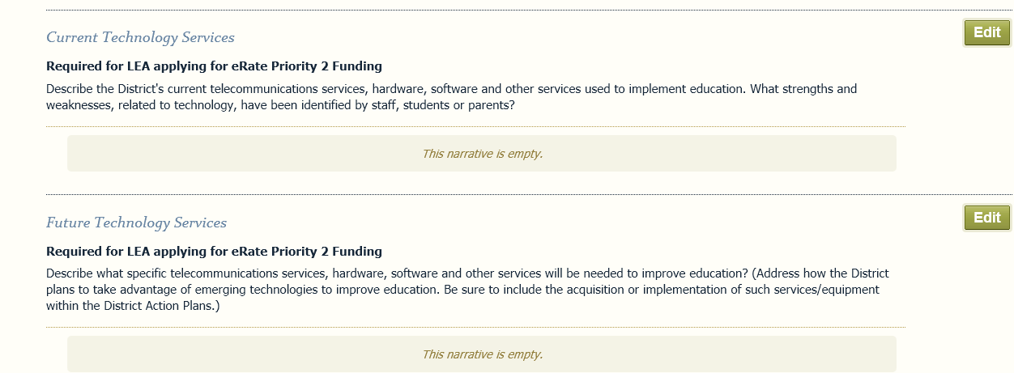
Core Foundations>Materials and Resources

Slide 13
Clear Goals and Realistic Strategy
Incorporating technology into the District Action Plan
Option 1: 1 broad tech goal with supporting strategies and action steps
Option 2: Overarching educational goals with supporting technology strategies
Must have at least 2 tech strategies and 1 must address professional development
Notes:
Note: District level plans can use a systemic challenge as a goal or create new

Slide 14
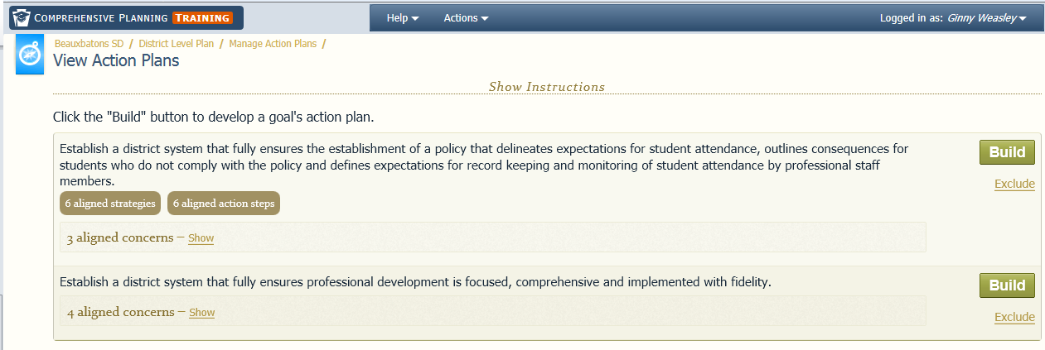
District Level Planning>View Action Plan

Slide 15
Professional Development
At least 1 goal should have professional development strategy and at least 1 specific professional development action step
Action steps selected as professional development have additional details
Ensure professional development is assisting staff to utilize technology effectively

Slide 16
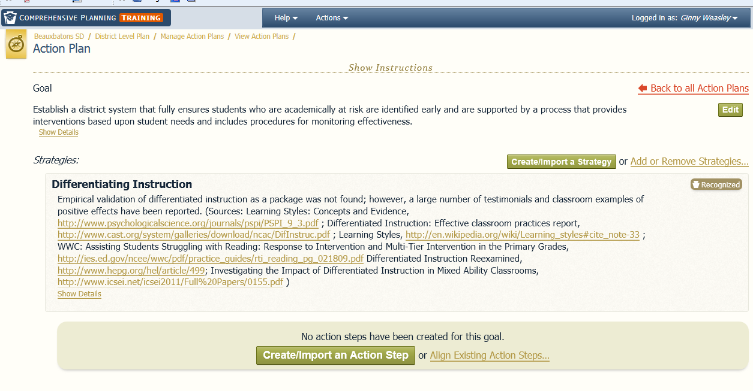
Build Action Plan

Slide 17
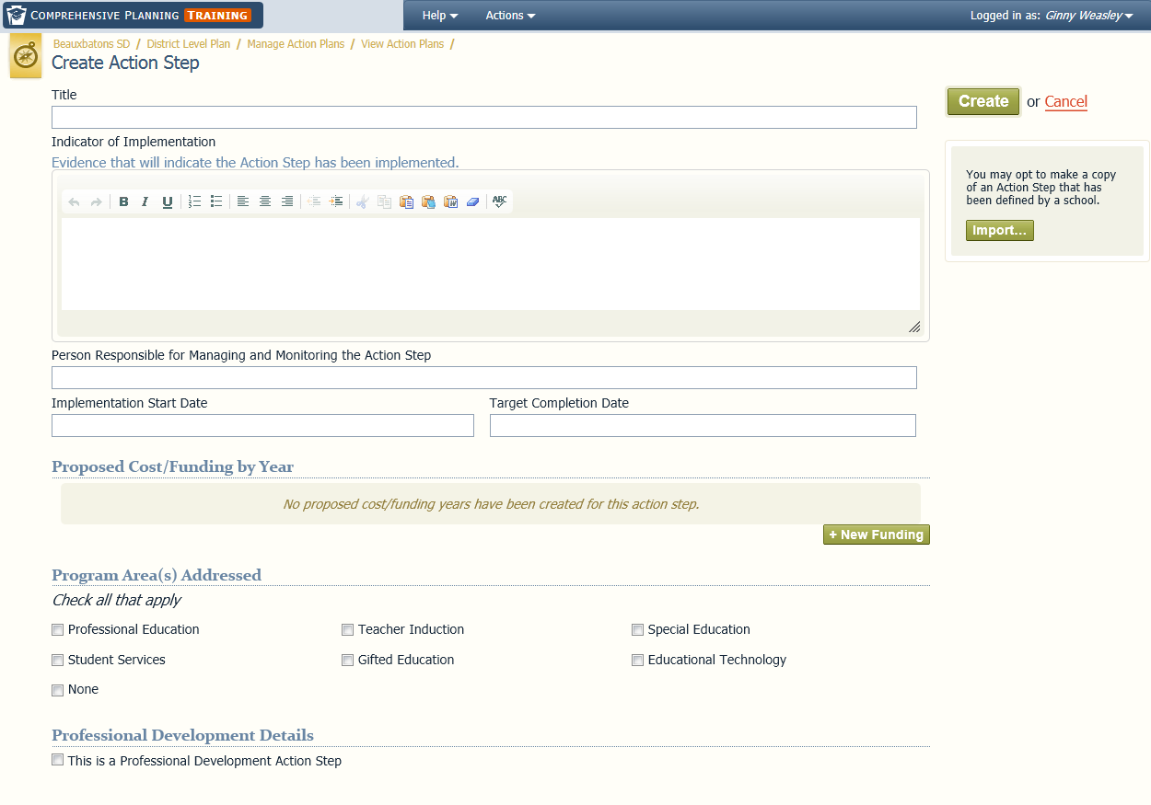
Professional Development Action Step

Slide 18
Evaluation Process
Evaluation process to monitor progress towards specified goals and make mid-course corrections
Monitoring of the implementation of your plan
Action Step> Indicator of Implementation
Evaluating the efficacy of your implementation
Goal> Indicator of Effectiveness

Slide 19
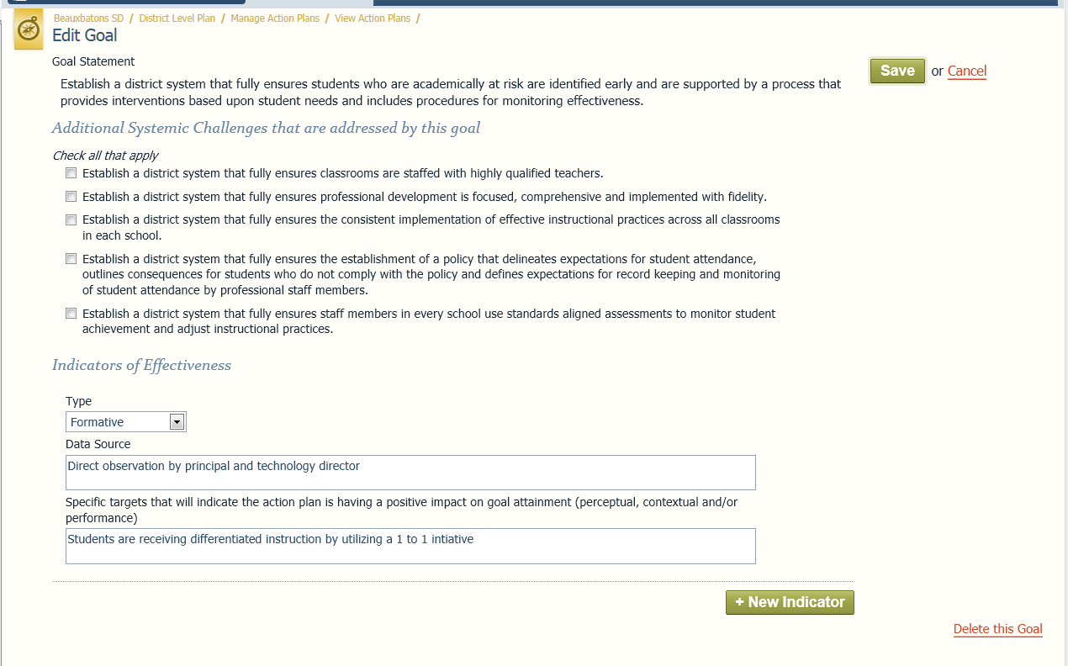
Goal> Indicator of Effectiveness
Notes:
Formative: focuses on program improvement, done early but can be done multiple times throughout (ongoing), used to provide information for program improvement
Summative: program results or impact, provides evidence of worth, occurs later, used to assess quality and impact of implemented program

Slide 20
Action Step> Indicator of Implementation
Notes:
How will you know action step is being implemented?
Who will monitor this? How often will it be monitored?

Slide 21
Budget
Prior E-rate planning requirement
Must provide sufficient budget to acquire and support non-discounted portion
Although not required in plan, LEA must still budget for technology expenditures
LEA encouraged to include anticipated costs for action steps

Slide 22
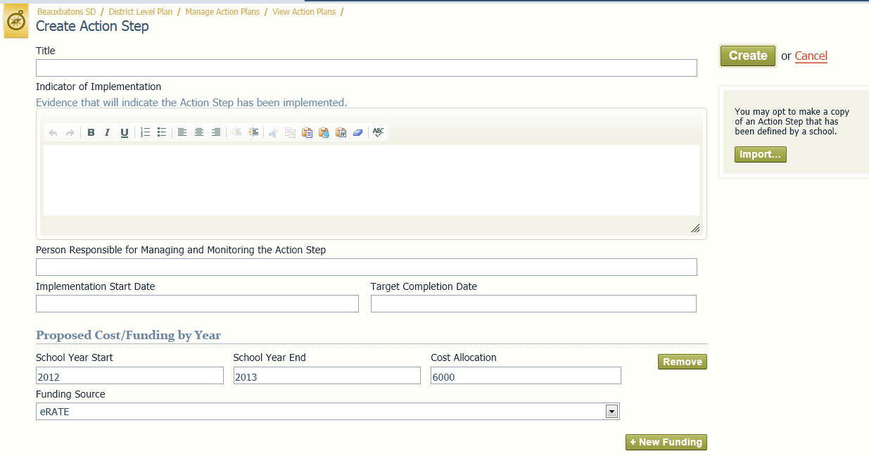
Action Step>Proposed Cost/Funding by Year

Slide 23
Accessing Comp Plan
Must have Education portal account
Must have minimum of Planning Author role
Either request access to group
Be granted access by Local Security Admin or Comp Plan – Local Admin
Comp Plan web application accessible under MY PDE Applications
www.education.state.pa.us

Slide 24
Comprehensive Planning
Comp Plan Web Application
http://training.paplanning.org
24
Notes:
24

Slide 25
Deadlines and Approval Process
The deadline for Phase 1 LEAs to have their Comp Plan submitted online is November 30, 2012
Plan will cover July 1, 2013 – June 30, 2016
Proposed Review process
Completed on Comp Plan web application
Optional Intermediate Unit Feedback
Optional Peer Feedback
Review by PDE – Educational Technologies staff
All Plans will be approved by PDE before July 1, 2013

Slide 26
Resources
CP Home Page
http://tinyurl.com/CP-PDE-Home
CP Listserv
http://tinyurl.com/CP-Listserv

Slide 27
E-rate Training
If you are new to the E-rate program and would like training, register now at:
http://www.e-ratepa.org/training_outreach.htm
Oct 29 – Pittsburgh Area (IU 7)
Nov 5 – Philadelphia Area (IU 23)
Nov 9 – Harrisburg Area (IU 15)
Training is free and open to all public and nonpublic schools and libraries in Pennsylvania.

Slide 28
Support and Assistance
Technical Assistance and planning questions
Comprehensive Planning Support Team
paplanning@caiu.org
717-732-8403
E-Rate program
Julie Tritt-Schell
jtschell@comcast.net

Slide 29
Questions?

